Slide 1
California House Value Forecast
Tom Cheng
Datas Science Career Track Capstone, May 20th 2020 Cohort

Slide 2

What’s forecast?
Use common sense and logics to find factors that may influence sales, in real estates: Time, Bedrooms, Bathrooms, and Zip-code of the estate are the main factors.

Slide 3

Why HOUSE VALUE FORECAST?
House Value Forecast helps both real estate investors and home buyers to determine if it’s a good time, place, or choice for their investment.

Slide 4
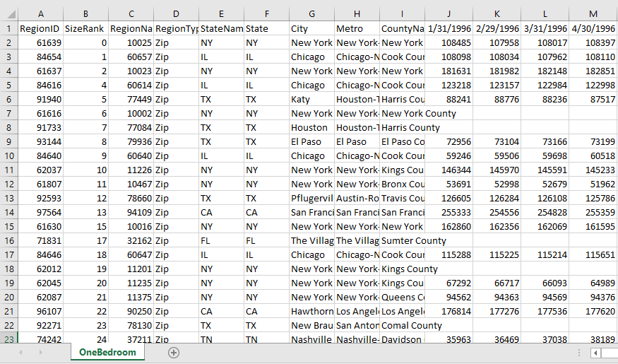
Where my data came from?
All of my data came from ZHVI, which can be downloaded from https://www.zillow.com/research/data/
Zillow Home Value Index (ZHVI): A smoothed, seasonally adjusted measure of the typical home value and market changes across a given region and housing type. It reflects the typical value for homes in the 35th to 65th percentile range.

Slide 5
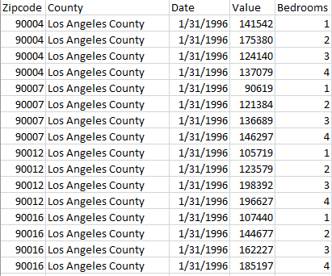
What did I do to the data?
All data must have estimates within the same time frame: Jan 1996 to Dec 2020
California Zip code, and County
Specified number of Bedrooms

Slide 6
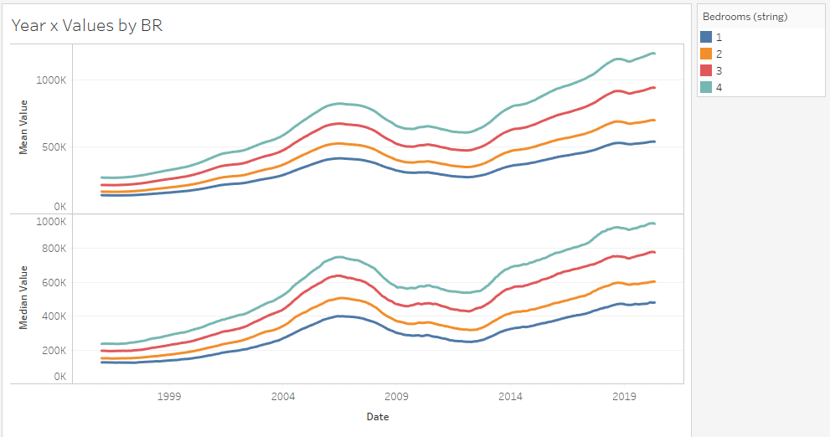
Exploratory Data Analysis (EDA) Year x Avg. Values colored by number of bedrooms.
Same trend for all 8 lines
More bedrooms means more value.
Obvious Mean > Median; this means huge outliers.

Slide 7
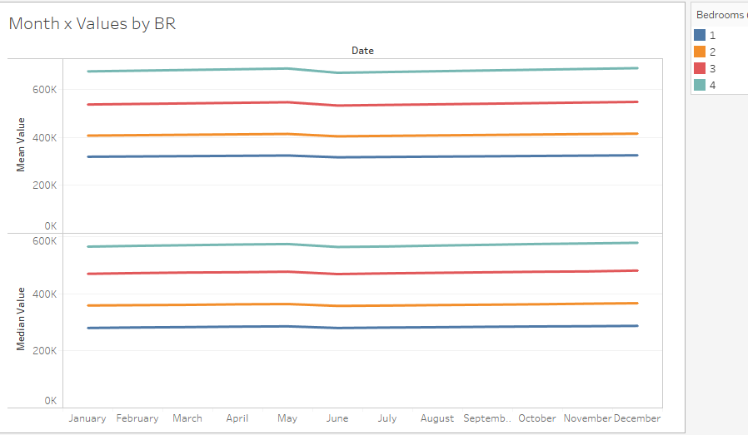
EDA cont. Month x values by Month
Month of year doesn’t seem to matter, so we can just focus on other factors.

Slide 8
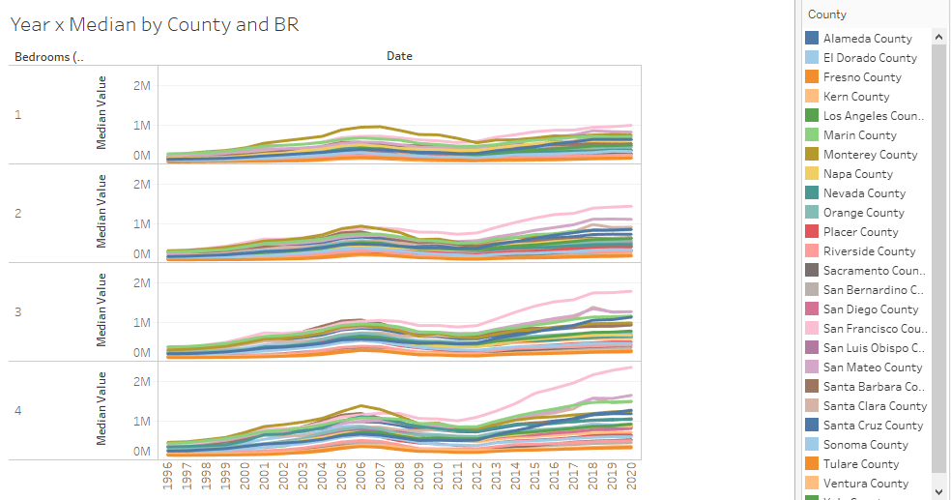
EDA cont. Year x Median by County and number of bedrooms
Much more variation than number of bedrooms.
San Francisco seems to rise much more as the number of bedrooms increases more than other county.

Slide 9
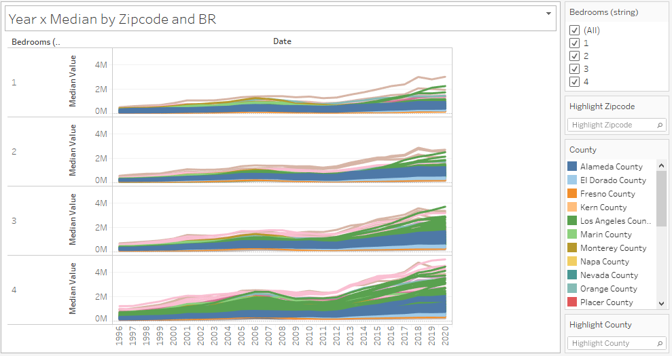
EDA cont. Year x Median by Zip Code and number of bedrooms
This plot shows the outliers, so the forecast should definitely include the zip code of the property.

Slide 10
Machine Learning Modeling
Type: Time Series Forecast
Tools: pandas, numpy, matplotlib, seaborn, datetime
Methods/Models:
Autoregressive Integrated Moving Average (ARIMA)
Vector Autoregressive Integrated Moving Average (VARMA)
Holt Winter’s Exponential Smoothing (HWES)

Slide 11
Modeling Steps
Data Preprocessing: time series format, no missing values, difference the data then 1/5th root the value to make it stationary.
Split to train/test, 1996 Jan-2015 Dec for training and 2016 Jan-2020 Dec for testing.
Use grid search to find best hyperparameters for each model
Use MAE, grid search time, and fitting time to evaluate the model’s performance

Slide 12
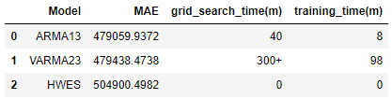
Model scores
ARMA has the lowest (best) MAE score, but does have grid search time of 40 minutes
VARMA’s grid search was terminated after more than 5 hours. The tested p was 1,2, and q was 1~3. When p=2, q=3, the model had best MAE.
HWES didn’t need grid search, and was trained in less than a minute.

Slide 13
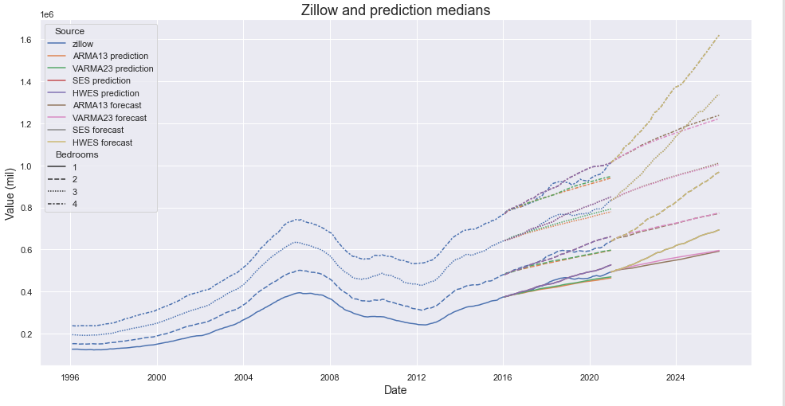
Model pred/fc median
HWES’s pred/test looked okay, but the forecast doesn’t seem realistic. It’s way too exponential, which usually isn’t how housing prices will grow.
ARMA and VARMA had very similar results, but due to time spent on modeling, ARMA is winner.

Slide 14
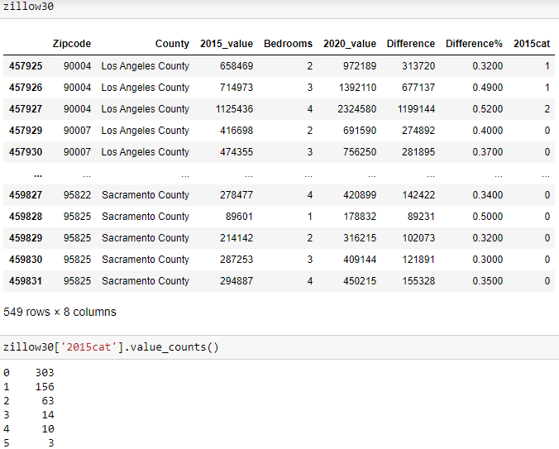
Price category
Adding a pricing category
0= 0~499,999
1 = 500,000~999,999
2 = 1000,000~149,999
3 = 1,500,000~19,999,999
Etc. I find out that houses with 30+% increase in 5 years, usually

Slide 15
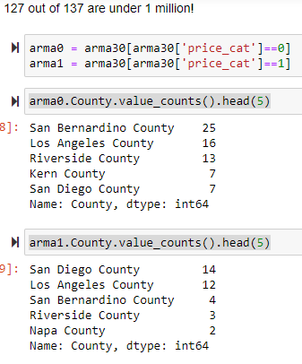
recommendation
Most of the properties were under one million
So, 2 price categories
Viewing the top 5 of each category by county

Slide 16

THANK YOU!

